Slide 1

European Investment Bank’s support to Just Transition
Public Sector Loan Facility

Slide 2
EIB and Just Transition Mechanism
Just Transition Mechanism
Financing
Pillar 1
Pillar 2
Pillar 3
  Just Transition Fund
  EIB can co-finance via structural programmes;
  EIB can also manage financial instruments utilising JTF funding
  InvestEU guarantee backed EIB financing
  Green/sustainable infrastructure, innovation, social & skills, SMEs and microfinance
  Public Sector Loan Facility
  EIB financing combined with EC grants for eligible public sector projects
Advisory
JASPERS supporting Member States with project preparation for JTF grants
InvestEU Advisory Hub
EIB provides advisory support to InvestEU projects
InvestEU Advisory Hub dedicated funding to support projects development and implementation

Slide 3
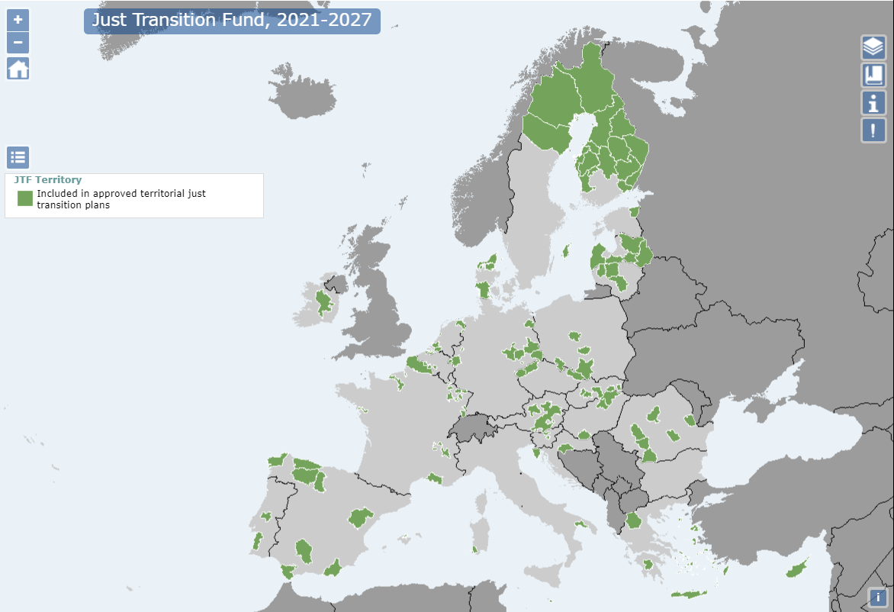
Updated eligibilities
As of the end of Jan. 2023, the EC had approved 67 TJTPs in 26 Member States, resulting in 91 territories that are eligible for JTM P3.
N.B: Projects need to be located in, or benefit, territories identified in a TJTP

Slide 4
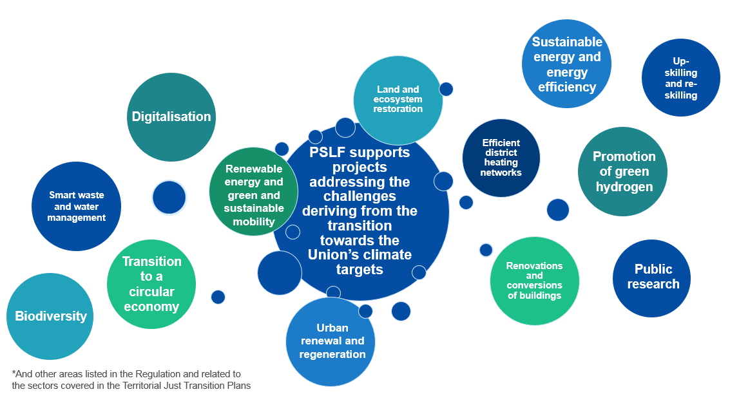
Sectoral eligibilities
N.B: Promoters need to demonstrate that projects cannot generate a sufficient stream of own revenues.

Slide 5
Loan Component of Public Sector Loan Facility (JTM Pillar 3)
PSLF is a Blending facility combining EIB loans and EU grants
Projects must address market failures, provide additionality and be “bankable”
Projects must comply with EIB sector policies, Paris Agreement and EU Taxonomy
Max grant component is 15/25% of loan amount (25% for less developed regions)
Minimum loan amount is €12.5 million, €1 million for intermediated loans
Investment loans may cover >50% of project cost for less developed and transition regions
Financing for individual projects or for groups of smaller projects …
Projects must not receive funding from other EU programmes

Slide 6
Types of EIB loans under PSLF: project size matters
Larger projects and beneficiaries
Smaller projects and beneficiaries
Investment Loans
Typically for large stand-alone projects
Framework Loans
Typically for large invest. programmes
Intermediated Loans
Through local banks & institutions
Project cost > EUR 25m
Loan > EUR 12.5m
Suitable for specific project (mature)
Single Promoter = Grant applicant to EC / CINEA
EIB loan pre-agreed before grant application
Programme cost > EUR 25m*
Loan > EUR 12.5m*
“Sub-projects” range EUR 50k-12.5m**
Suitable for Investment Programme (Tranches, many “sub-projects” and multisector)
Loan can be “Coordinated”: the borrower transfers grant/loan to sub-projects’ promoters
Project cost in range EUR 2-25m
Loan range EUR 1-12.5m
Accessible through EIB’s financing partners - intermediaries
Project promoter applies for grant directly to EC / CINEA
Before applying for the Grant, the Promoter should have signed a loan with the financial intermediary.
* The value as shown can be also considered on the basis of a tranche of the EIB financing ** Upper limit valid for Coordinated FL, due to Financial Regulation limitations.

Slide 7
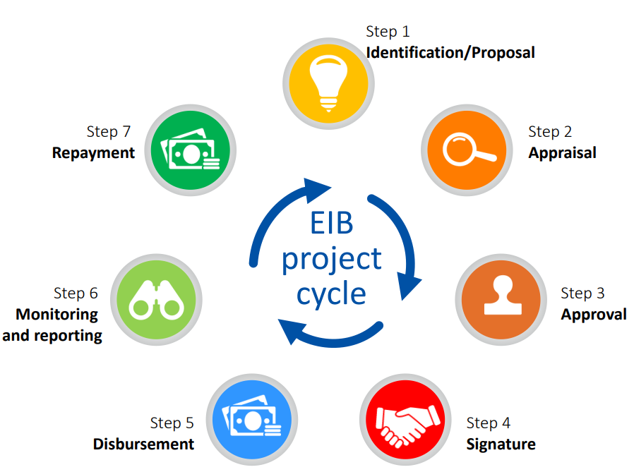
PSLF origination and flagging
Officially, the signed Loan request letter should be the point in the process when the Promoter can submit the grant application (stable loan amount).

Slide 8


How to apply for and receive funds for a PSLF project?
Submission of a grant proposal to the Commission
Grant assessment
(up to 3 months)
Grant agreement preparation and
award decision adoption
Signature of the
grant agreement
Submission of a loan request to the EIB
Loan assessment
(up to 18 months)
Approval of
the loan
Signature of the financing agreement
Grant is conditioned upon obtaining EIB loan. Contact EIB as early as possible in the process, to pre-agree the project scope, size and the loan amount.
EIB may confirm that a project is eligible for PSLF only when the project is well defined, i.e. once the appraisal is in advanced stage.

Slide 9



EIB Advisory Services
From an enabling environment…
…through preparation and planning…
… to high-quality projects delivery
UPSTREAM
Policy & programme advice
Preliminary project assessment
PREPARATION
Technical advice
Financial advice
Consultancy assistance
IMPLEMENTATION
Advice on project implementation
Enhanced monitoring
CAPACITY BUILDING
Technical issues – Cooperation centres of expertise - Dissemination best practices & case studies – Needs Assessment for project advisory support

Slide 10


THANK YOU!
InvestEU Advisory Hub
EIB-Advisory-Public@eib.org
b.gabrovska@eib.org
Contact for the Public Sector Finance in Latvia:
Marina Ismaila., mob. 29167934
m.ismaila@eib.org
ES Mājā, 2.st., Aspazijas 28., Rīgā

